Slide 1
MATLAB’s Deep Learning Toolbox
by : George and Tanner

Slide 2
Program Overview
problem statement
dataset
neural network
script

Slide 3
Problem Statement
Train a neural network to identify if an facial image is wearing a mask

Slide 4
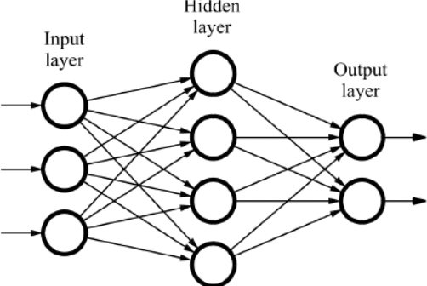
Neural Network
neural networks are inspired by the brain
A neural network has
Input layer
Hidden layers
Output layer

Slide 5
Strategy
Get a dataset that contains facial images with/without facemasks
Choose the ML model
Choose how to train the model
Use MATLAB’s deepNetworkDesigner app to apply transfer learning
Create a MATLAB script to test the model

Slide 6
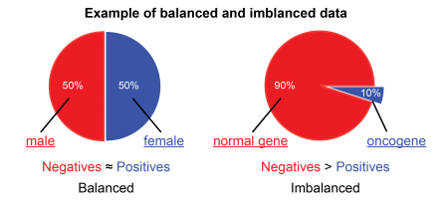




Dataset
Datasets can be found on websites like Kaggle and Github
We used Kaggle
This dataset has almost 12K images and is balanced
Has 3 Folders: Train, Validate, and Test
Link to dataset: https://tinyurl.com/y8d3kdw4

Slide 7
Model
Binary Classification Model - Model predicts a binary outcome (mask / no mask)

Slide 8
Training the Model
Transfer Learning - using the knowledge gained from a pre-trained network to apply it to a similar problem
The pre-trained network we will use is SqueezeNet

Slide 9
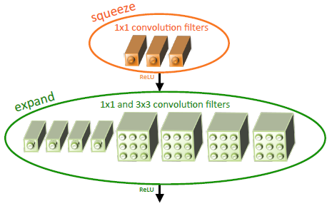
SqueezeNet
A convolutional neural network
Used for computer vision
Small size, can be compressed to < 5 MB
Developed by DeepScale, UC Berkeley, and Stanford University
Incentive: it comes downloaded with MATLAB’S Deep Learning Toolbox
Original Paper : https://arxiv.org/abs/1602.07360
Article on SqueezeNet : https://tinyurl.com/346nfrc5

Slide 10
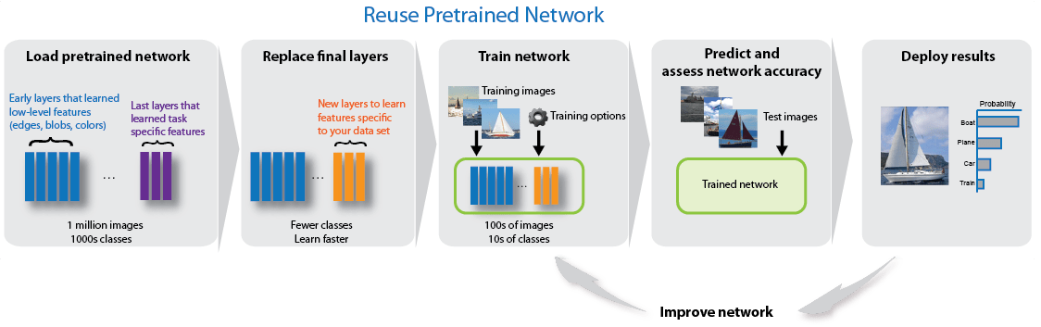

Slide 11
Cost Function
Used to estimate how badly a model is performing
Small when image is classified correctly
Large when image is classified incorrectly

Slide 12
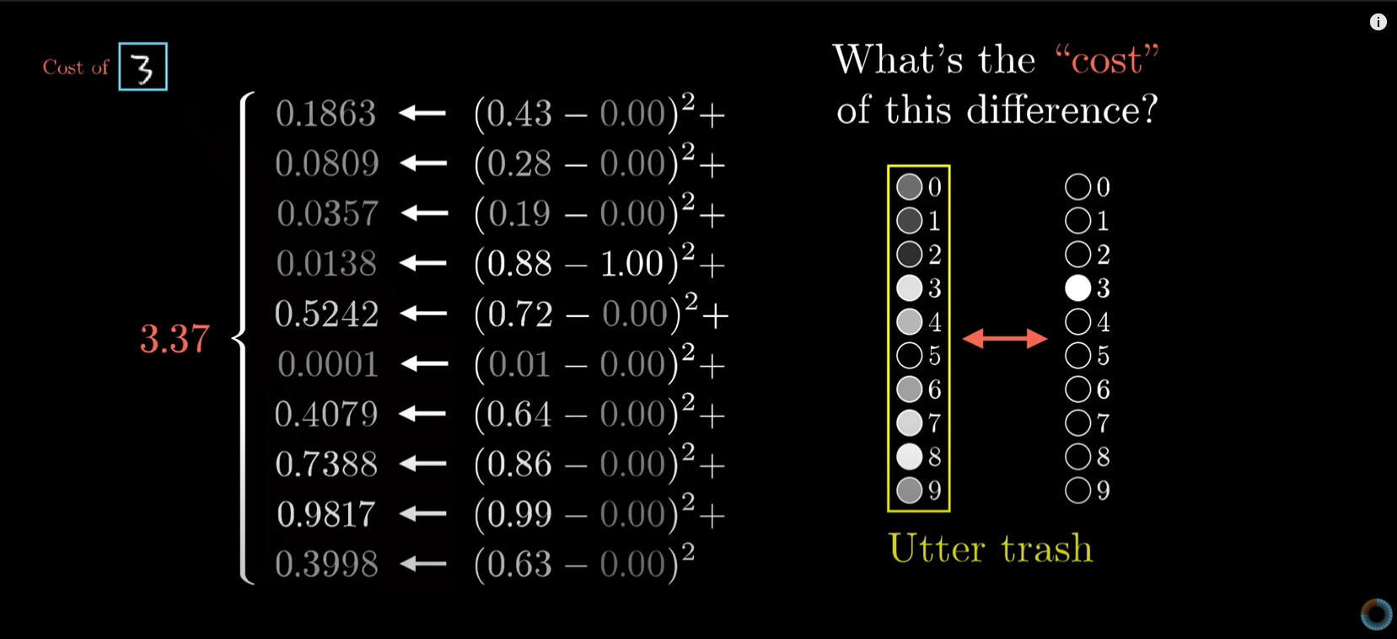
Bad Classification
Image from 3Blue1Brown

Slide 13
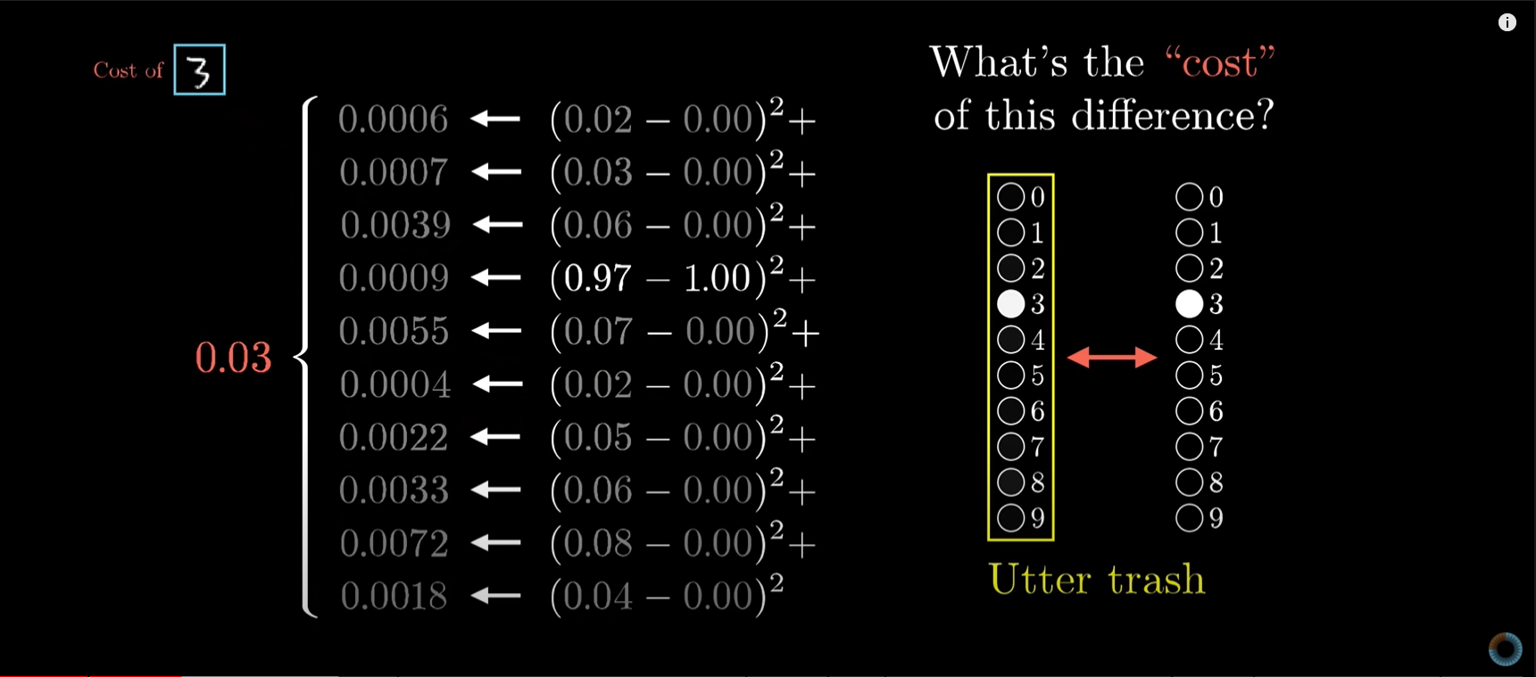
Good Classification
Image from 3Blue1Brown

Slide 14
Gradient Descent
This is an optimization algorithm that is used to train a model
∇Gradient - the direction of steepest increase
Think of x and y as inputs and z as the output of the cost function. Z = C(x,y)
We assign x and y random values then let gradient descent walk us down in the steepest direction to the red arrow at the bottom (minimum of the cost function)
How big the steps gradient descent takes is based on the learning rate

Slide 15
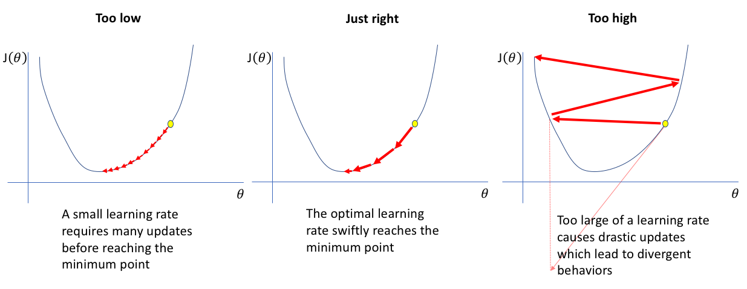
Learning Rate
Learning Rate - most important hyperparameter, controls how fast the network “learns”

Slide 16
Other Parameters
validation frequency - the rate at which the validation set is tested against the model
number of epochs - the number of times the dataset is seen by the network during training
batch size - number of training examples used in one iteration
Iterations per epoch = sample size / batch size
Max iterations = iterations per epoch * number of epochs

Slide 17
deepNetworkDesigner App
Import and edit trained networks.
Build new networks from scratch.
Add training and validation data
Adjust hyper parameters
Train the network

Slide 18
Demo: deepNetworkDesigner

Slide 19
Script
Input and display training images
Input trained network and test images
Calculate and display the accuracy of the trained network on the test images
Have user input test images to classify

Slide 20
Demo: Script

Slide 21
Want to learn more?
Playlist on Neural Networks by 3Blue1Brown
https://tinyurl.com/938x9ac

Slide 22
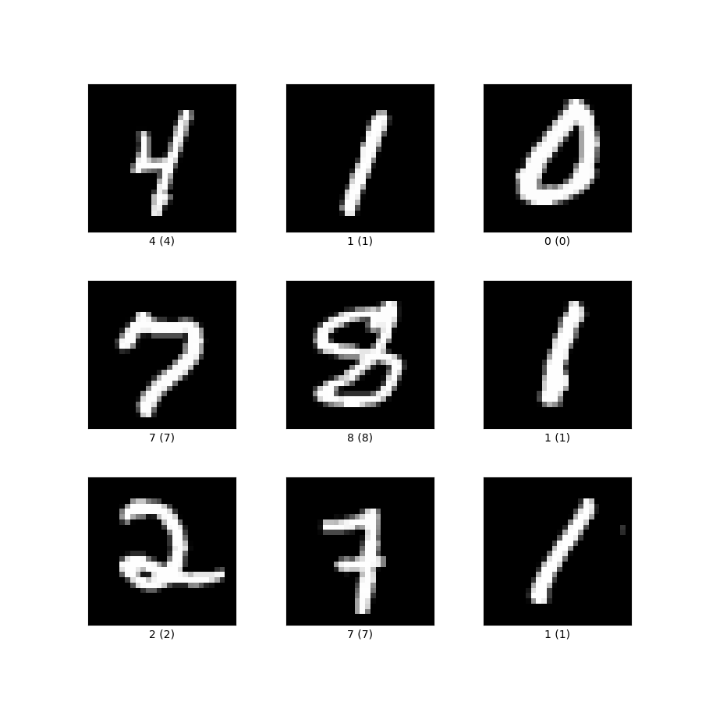
Try it yourself!
MNIST Handwritten Images Dataset: https://www.kaggle.com/scolianni/mnistasjpg

Slide 23
References
Arasanipalai, A., 2021. A Practical Guide To Hyperparameter Optimization. [online] AI & Machine Learning Blog. Available at: <https://nanonets.com/blog/hyperparameter-optimization/> [Accessed 1 September 2021].
Brownlee, J., 2021. How to Configure the Learning Rate When Training Deep Learning Neural Networks. [online] Machine Learning Mastery. Available at: <https://machinelearningmastery.com/learning-rate-for-deep-learning-neural-networks/> [Accessed 1 September 2021].
Donges, N., 2021. Gradient Descent: An Introduction to 1 of Machine Learning’s Most Popular Algorithms. [online] Built In. Available at: <https://builtin.com/data-science/gradient-descent> [Accessed 1 September 2021].
Sanderson, G., 2017. Gradient descent, how neural networks learn. [online] 3blue1brown.com. Available at: <https://www.3blue1brown.com/topics/neural-networks> [Accessed 1 September 2021].
Yiu, T., 2019. Understanding Neural Networks. [online] towardsdatascience. Available at: <https://towardsdatascience.com/understanding-neural-networks-19020b758230> [Accessed 1 September 2021].

